Slide 1

9/09/2024
Convolutional
Neural Networks
High Performance Machine Learning Group

Slide 2
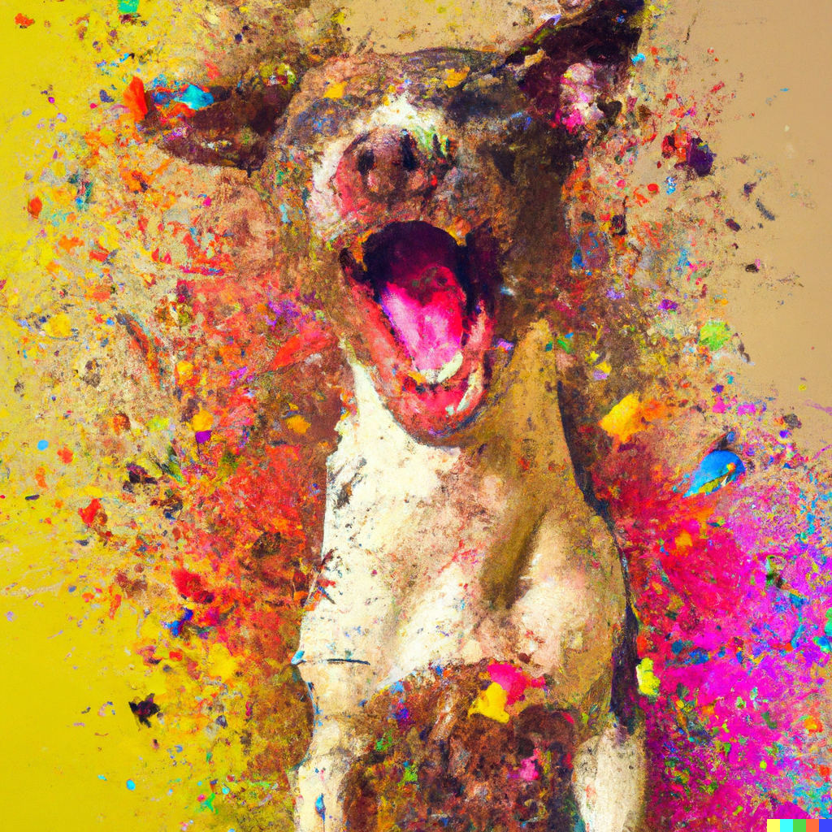


Image Representation
Is a matrix or grid of intensity values
integers [0, 255] or float points [0,1]
Each element in the matrix is a pixel
Can have 1 greyscale channel or multiple colour channels: RGB

Slide 3
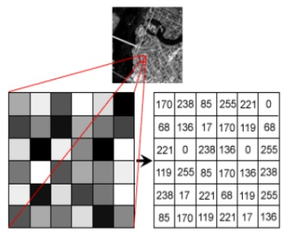
Image Representation
Is a matrix or grid of intensity values
integers [0, 255] or float points [0,1]
Each element in the matrix is a pixel
Can have 1 greyscale channel or multiple colour channels: RGB

Slide 4
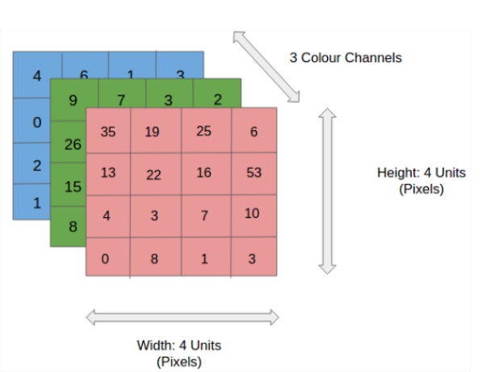
Image Representation
Is a matrix or grid of intensity values
integers [0, 255] or float points [0,1]
Each element in the matrix is a pixel
Can have 1 greyscale channel or multiple colour channels: RGB

Slide 5
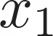

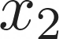
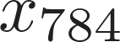
Correlated structures
...
...
...
...

Slide 6
Correlated structures
...
...
...
...
Images are correlated spatially
Strong correlation between neighbouring pixels
Shifting an object will not alter its essence

Slide 7
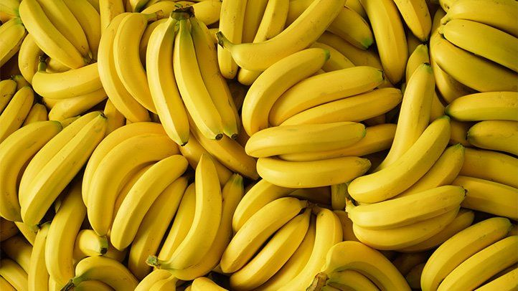
Correlated structures
...
...
...
...
Images are correlated spatially
Strong correlation between neighbouring pixels
Shifting an object will not alter its essence

Slide 8
Correlated structures
...
...
...
...
Images are correlated spatially
Strong correlation between neighbouring pixels
Shifting an object will not alter its essence

Slide 9
Correlated structures
...
...
...
...
Images are correlated spatially
Strong correlation between neighbouring pixels
Shifting an object will not alter its essence

Slide 10
Correlated structures
...
...
...
...
Images are correlated spatially
Strong correlation between neighbouring pixels
Shifting an object will not alter its essence

Slide 11
Correlated structures
...
...
...
...
Images are correlated spatially
Strong correlation between neighbouring pixels
Shifting an object will not alter its essence
Detect the features across an image and aggregate them
Form complete features higher up in the hierarchy (in later layers)

Slide 12
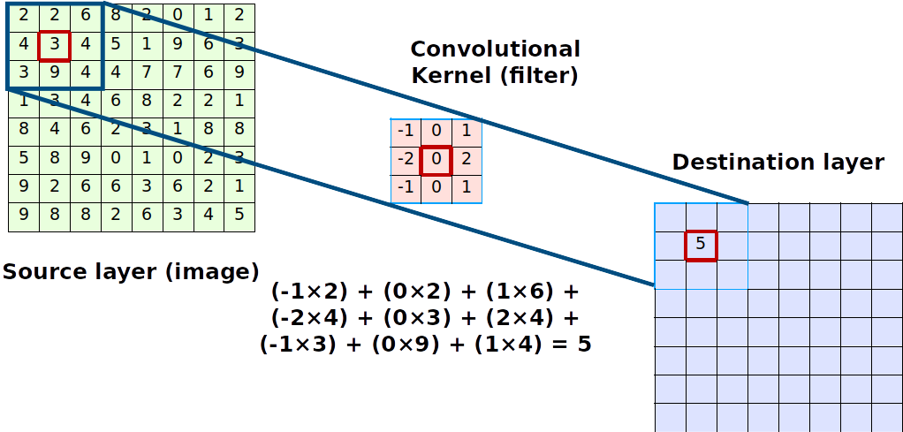

Convolutions Compute

Slide 13
Convolutions Compute
The kernel is shifted across the image and produces a point value
The step size in which it shifts is the stride
The output is always smaller. We can use padding to preserve dimensions

Slide 14
Convolutions Compute
The kernel is shifted across the image and produces a point value
The step size in which it shifts is the stride
The output is always smaller. We can use padding to preserve dimensions
The image shrinks according to
Output_size = inputSize -(KernelSize - 1)

Slide 15
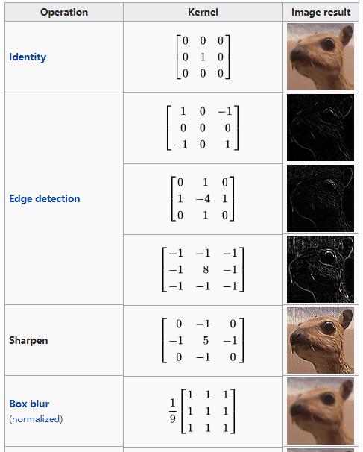
Convolutions
Kernel (filter): small matrix that we use to convolve an image
Convolution:
An operation that “blends” one function with another.
A filter applies a convolution operation on an image

Slide 16
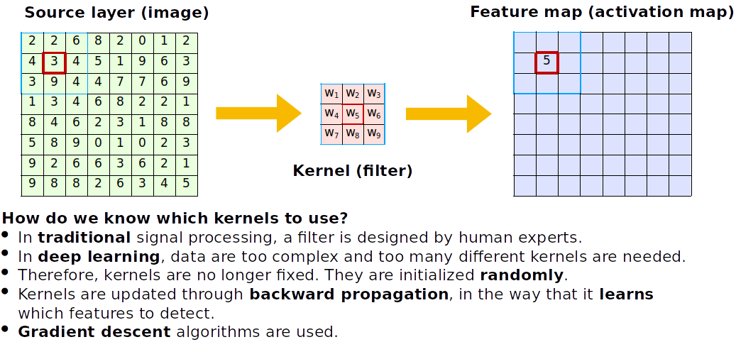
Convolutions

Slide 17
Convolutions
How do we know which kernels to use?
Kernels are initialized randomly and learnt during training, allowing the CNN to learn spatial features

Slide 18
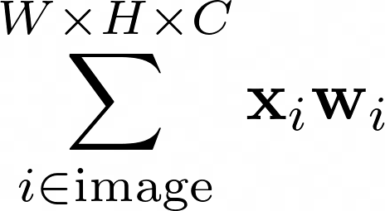
Convolutions
Fully connected
How do we know which kernels to use?
Kernels are initialized randomly and learnt during training, allowing the CNN to learn spatial features

Slide 19
Convolutions
Fully connected
How do we know which kernels to use?
Kernels are initialized randomly and learnt during training, allowing the CNN to learn spatial features

Slide 20
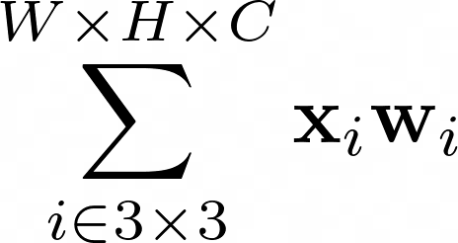
Convolutions
Fully connected
Locally connected
shared weights
How do we know which kernels to use?
Kernels are initialized randomly and learnt during training, allowing the CNN to learn spatial features

Slide 21
Convolutions
Fully connected
Locally connected
shared weights
How do we know which kernels to use?
Kernels are initialized randomly and learnt during training, allowing the CNN to learn spatial features

Slide 22
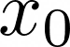
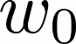
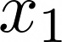
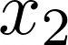
Anatomy of an Convolutional Neural Network
CNNs actually look a lot like normal Dense Neural Networks
Interpretation: Every node is a kernel

Slide 23
Anatomy of an Convolutional Neural Network
See the nodes as moving across the image!
We say these are shared weights
CNNs actually look a lot like normal Dense Neural Networks
Interpretation: Every node is a kernel

Slide 24

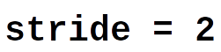
Pooling
We could discard information gradually by max pooling
Keep the strongest signal, works better than average pooling
Nowadays, we use a bigger convolution stridefor dimensionality reduction

Slide 25
CNN Cases
High Performance Machine Learning Group

Slide 26
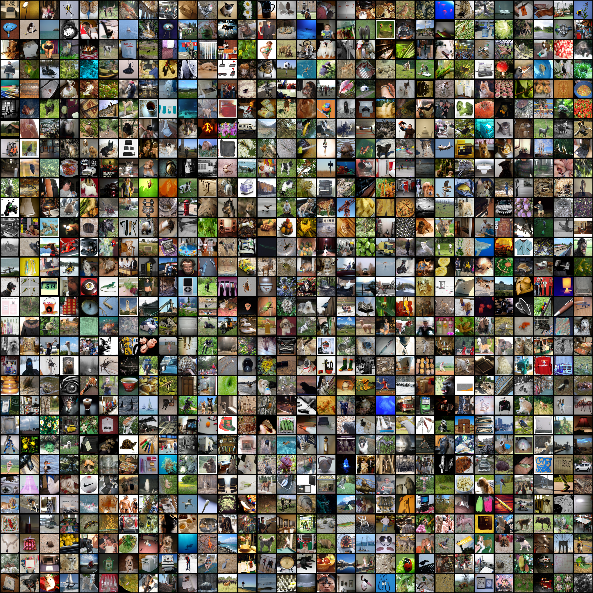

ImageNet Challenge
Computer Vision Benchmark 1.4M Images, 1000 classes
Image Classification Difficult until 2012

Slide 27
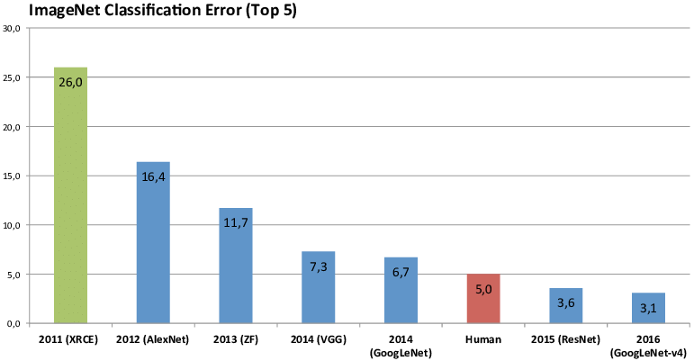
ImageNet Challenge
Computer Vision Benchmark 1.4M Images, 1000 classes
Image Classification Difficult until 2012

Slide 28
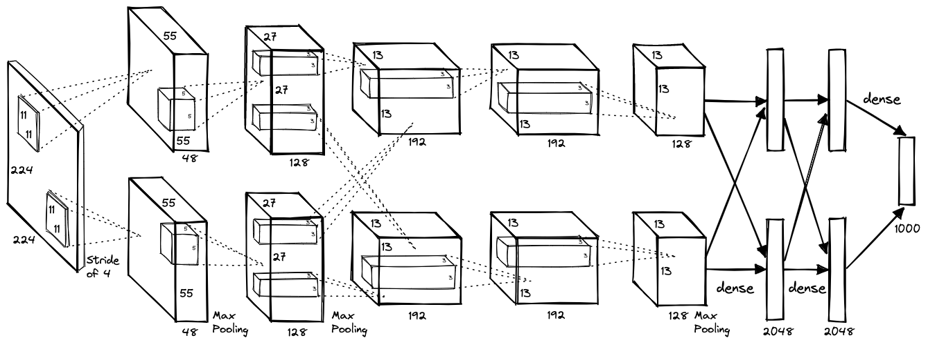
AlexNet (2012)

Slide 29
AlexNet (2012)
Images become smaller and number of filters increases as we go deeper
8 layers with dropout and ReLU activations trained for 6 days on 2 GPUs

Slide 30
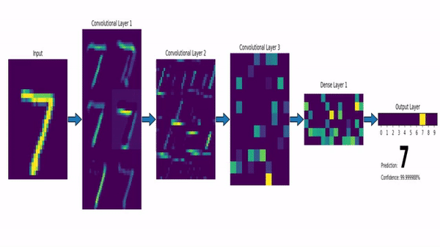
CNN with a Dense Layer output
https://www.louisbouchard.ai/densenet-explained/

Slide 31
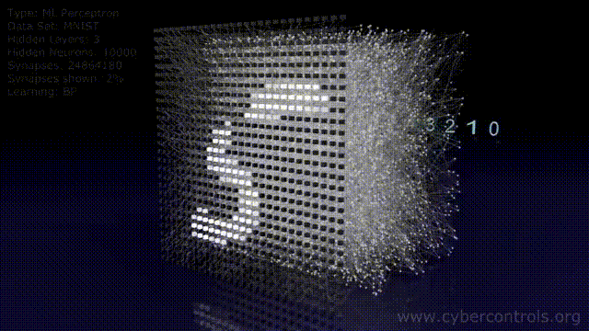

Slide 32
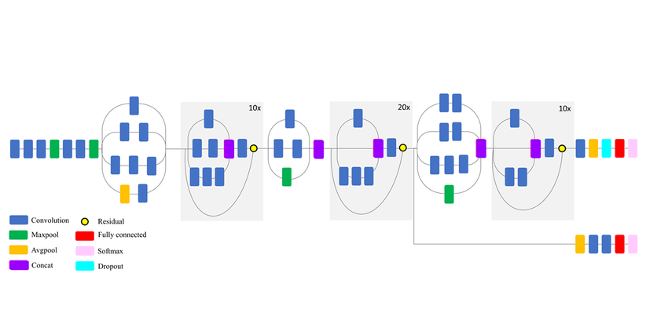
Transfer Learning

Slide 33
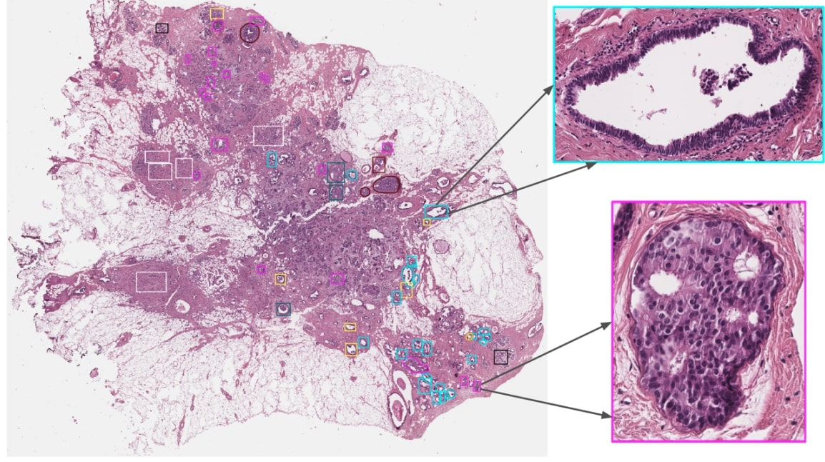
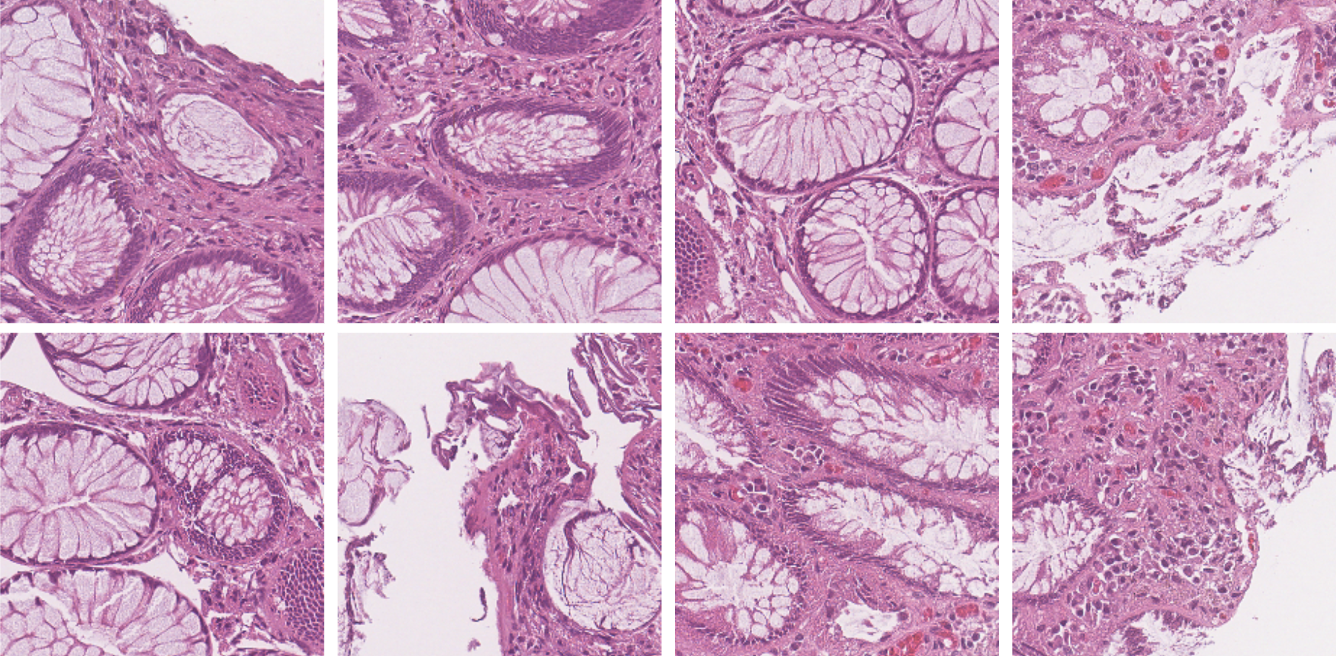
Transfer Learning

Slide 34

VGG16 and ResNet (2014, 2015)
VGG16: construct large and deep models (120M params)
Prevents vanishing gradient problem

Slide 35
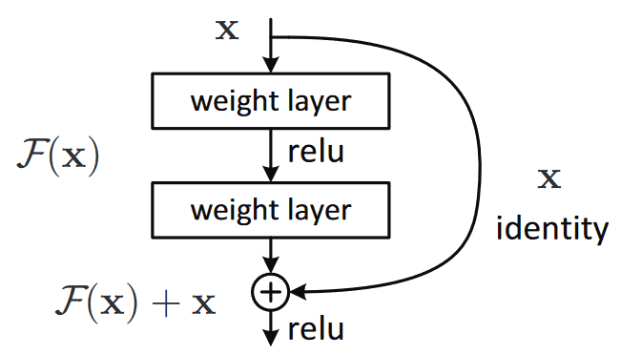
VGG16 and ResNet (2014, 2015)
VGG16: construct large and deep models (120M params)
Prevents vanishing gradient problem

Slide 36
ResNet (2015)

Slide 37
ResNet (2015)
ResNets: construct large and deep models with skip connections, able to train up to 152 layers (!)
Higher abstraction and less nuisance from vanishing or exploding gradients

Slide 38
ResNet (2015)
ResNets: construct large and deep models with skip connections, able to train up to 152 layers (!)
Higher abstraction and less nuisance from vanishing or exploding gradients
Early layers learn features that get progressively more abstract, we can preserve and control the flow of information with skip connections

Slide 39
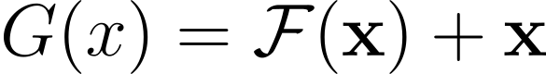
ResNet (2015)

Slide 40
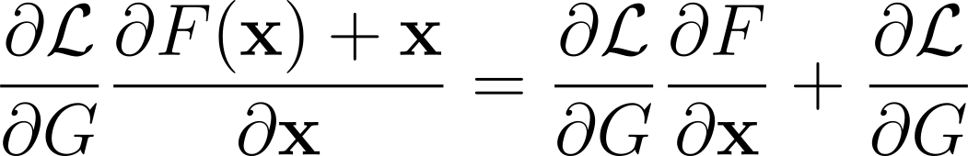
ResNet (2015)

Slide 41
ResNet (2015)

Slide 42
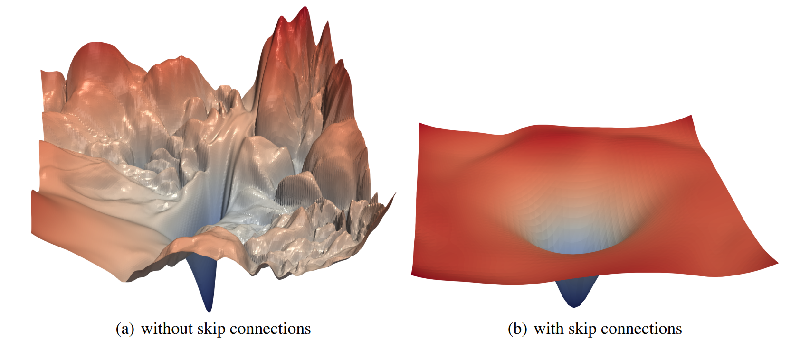
Li, H., Xu, Z., Taylor, G., & Goldstein, T. (2017). Visualizing the Loss Landscape of Neural Nets. NIPS
ResNet (2015)

Slide 43
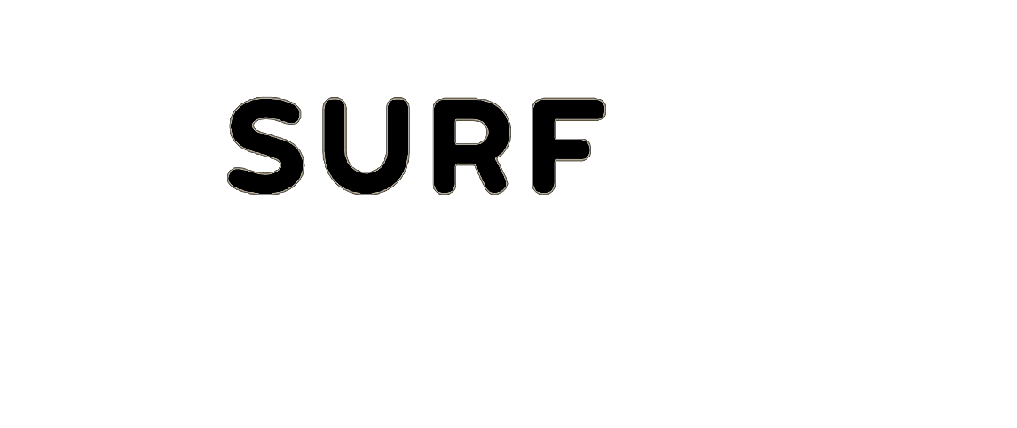
09/9/2024
Thank You
High Performance Machine Learning Group

Slide 44
Slides Graveyard
High Performance Machine Learning Group

Slide 45
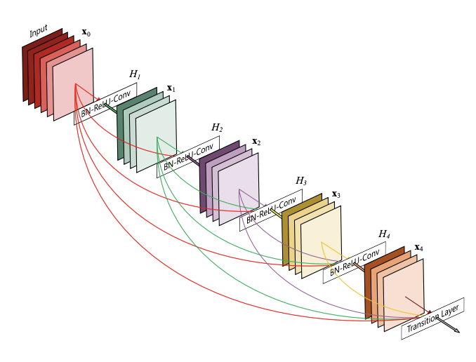
DenseNet (2016)
ResNets: construct large and deep models with skip connections, able to train up to 152 layers (!)
Higher abstraction and less nuisance from vanishing or exploding gradients
Early layers learn features that get progressively more abstract, we can preserve and control the flow of information with skip connections

Slide 46
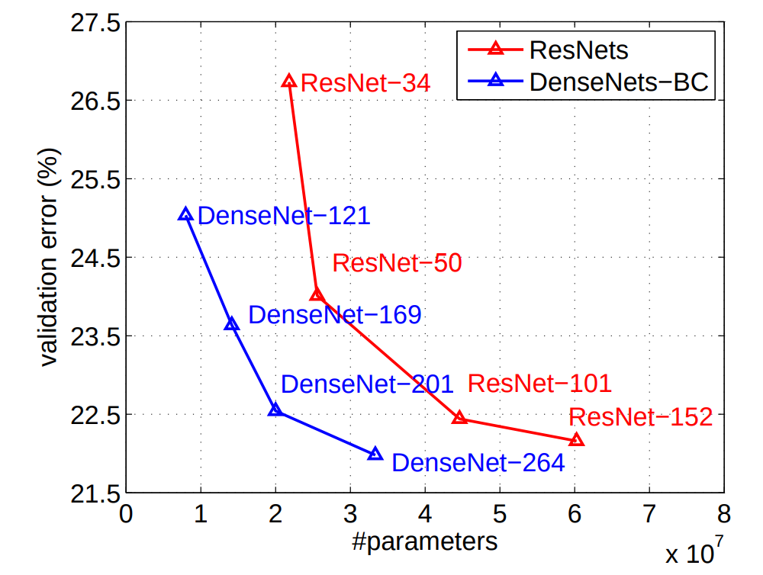
DenseNet (2016)
ResNets: construct large and deep models with skip connections, able to train up to 152 layers (!)
Higher abstraction and less nuisance from vanishing or exploding gradients
Early layers learn features that get progressively more abstract, we can preserve and control the flow of information with skip connections

Slide 47
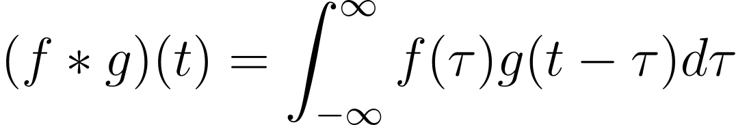
The Convolution Operation

Slide 48
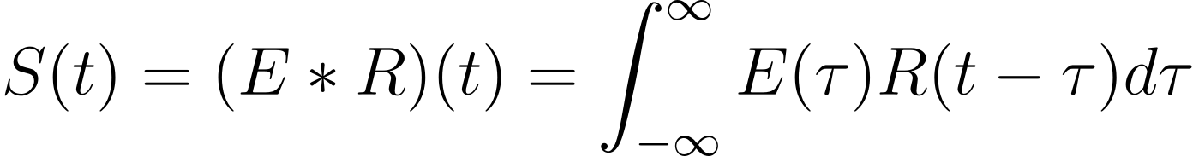
The Convolution Operation

Slide 49
The Convolution Operation
Impulse Response

Slide 50
The Convolution Operation
Source Signal
Impulse Response

Slide 51
The Convolution Operation
Seismogram
Source Signal
Impulse Response

Slide 52
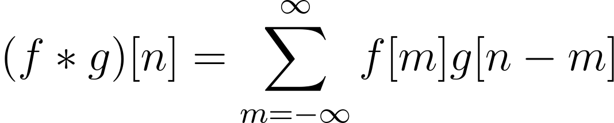
The Convolution Operation

Slide 53
The Convolution Operation
Initial signal gets modified by the system’s response
One signal slides across the other

Slide 54
Convolutions
Kernel (filter): small matrix that we use to convolve an image

Slide 55
Convolutions
Kernel (filter): small matrix that we use to convolve an image
Convolution:
An operation that “blends” one function with another.

Slide 56
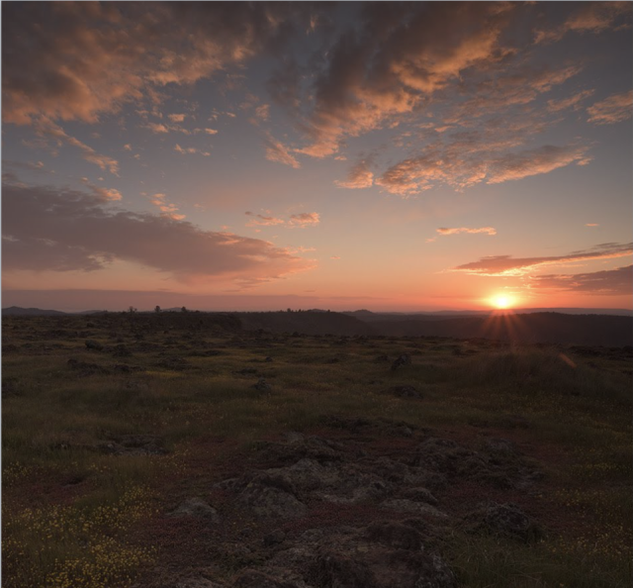

Convolutions
Kernel (filter): small matrix that we use to convolve an image
Convolution:
An operation that “blends” one function with another.
A filter applies a convolution operation on an image

Slide 57
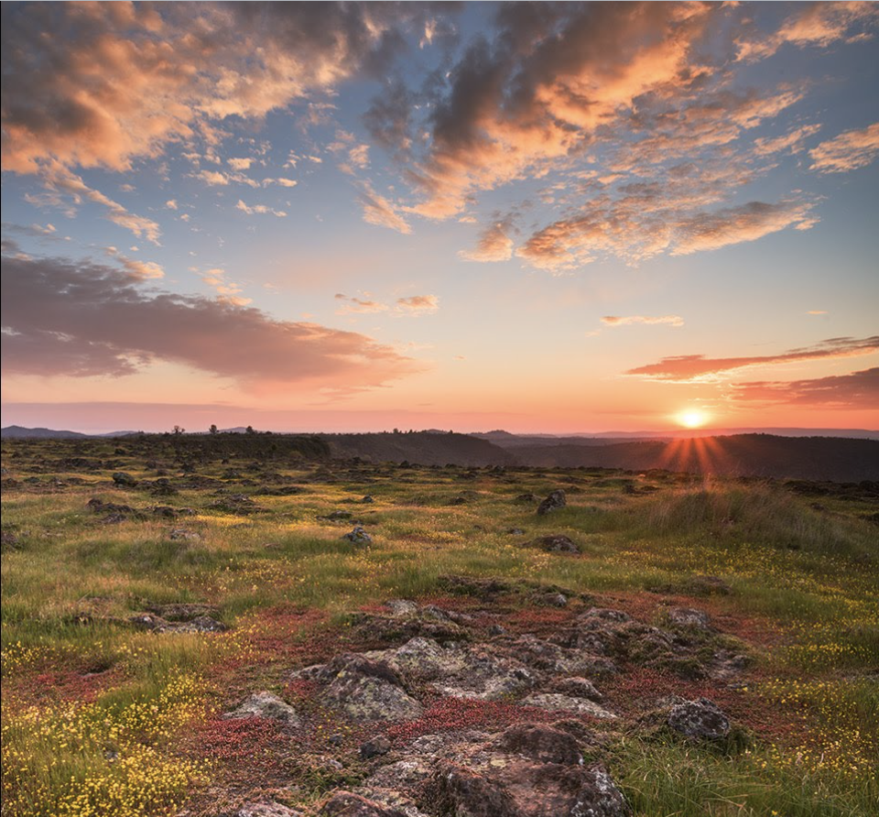
Convolutions
Kernel (filter): small matrix that we use to convolve an image
Convolution:
An operation that “blends” one function with another.
A filter applies a convolution operation on an image

Slide 58
How do Humans see?

Slide 59
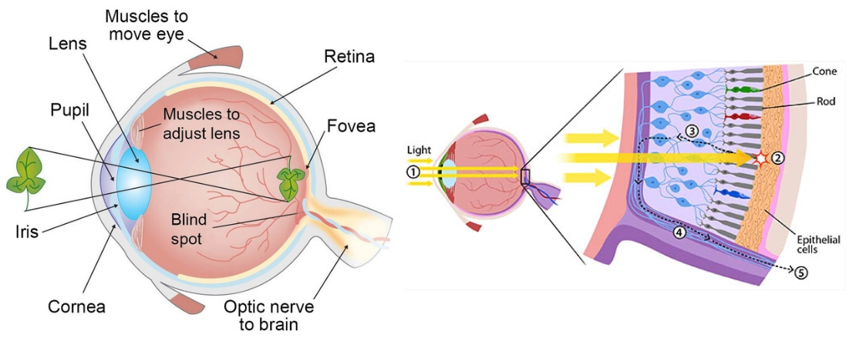
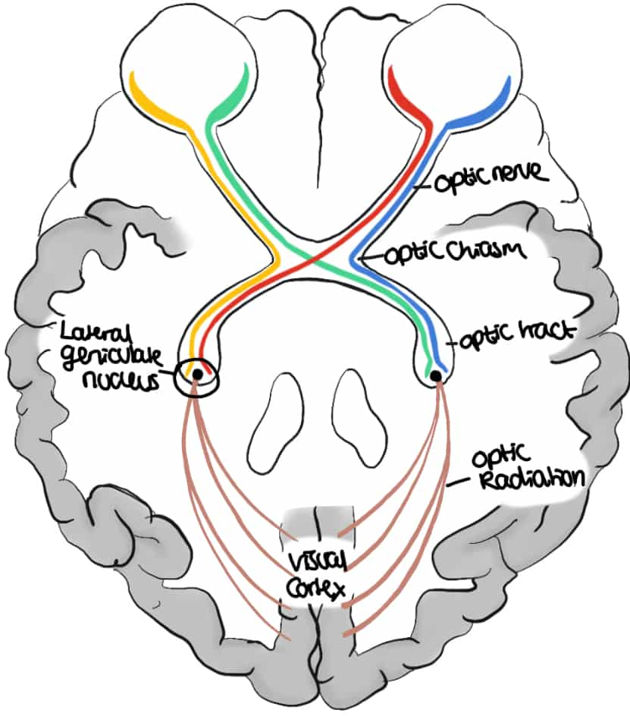
Mammalian Visual System

Slide 60
Mammalian Visual System
Cones and rods picks up photons and propagate the signal to the back of our brain
Along the way, the signal gets processed in stages

Slide 61
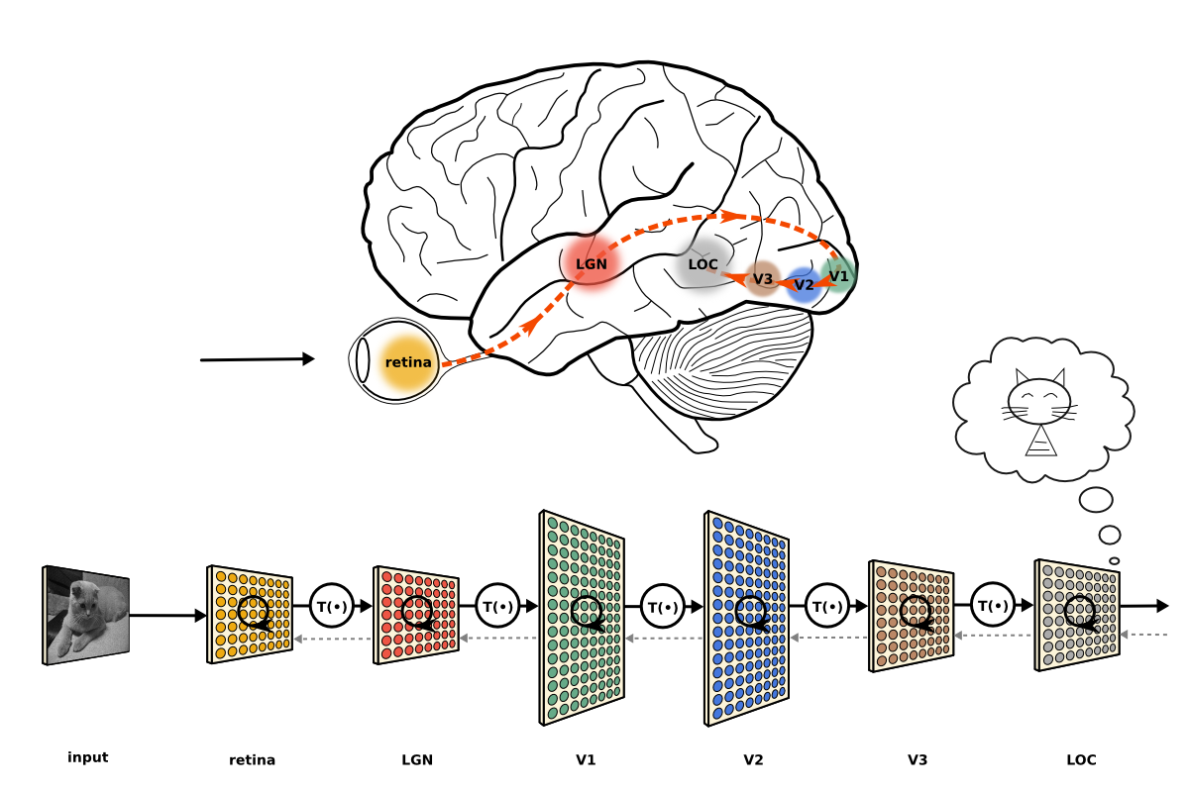
Mammalian Visual System
Cones and rods picks up photons and propagate the signal to the back of our brain
Along the way, the signal gets processed in stages
The extracted information gets aggregated and formed into an image

Slide 62
Mammalian Visual System
Cones and rods picks up photons and propagate the signal to the back of our brain
Along the way, the signal gets processed in stages
The extracted information gets aggregated and formed into an image

